Slide 1


Man Su, Ph.D.
Postdoc
Learning to Adapt, Learning with Agency Lab (LaLa Lab)
Saarland Informatics Campus, Saarland University
mansu@cs.uni-saarland.de | mansu.net
Fostering Strategic Choice Making
through Motivational Pedagogical Agents in an Adaptive Learning System
Man Su (Echo), Katharina Bonaventura, Tomohiro Nagashima
Saarland University, Saarland Informatics Campus, Germany

Slide 2
Fostering Strategic Choice Making
through Motivational Pedagogical Agents in an Adaptive Learning System
Bigger Question: How can adaptive learning systems support students not just in what they learn, but in how they make strategic learning choices?

Slide 3
Fostering Strategic Choice Making
through Motivational Pedagogical Agents in an Adaptive Learning System
Bigger Question: How can adaptive learning systems support students not just in what they learn, but in how they make strategic learning choices?
Research Question: How do motivational pedagogical agents impact students’ conceptual learning and choice-making behaviors, especially across students with different prior knowledge?

Slide 4
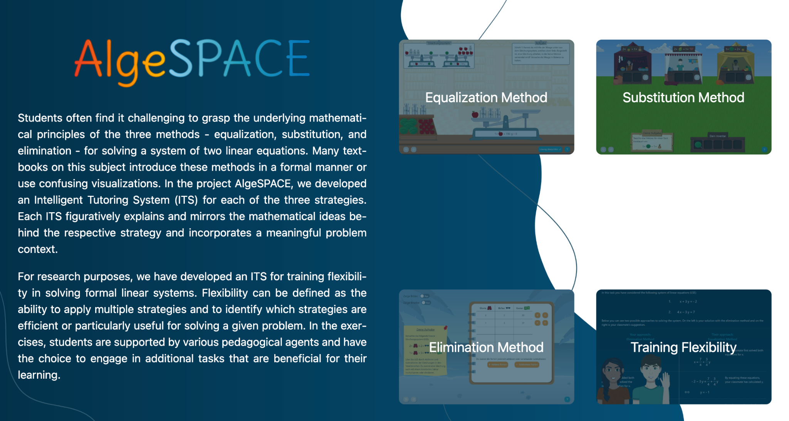
AlgeSPACE (Algebra Scaffolding with Pedagogical Agents and Concrete Examples)
https://algespace.sic.saarland/
Nagashima et al (2024)

Slide 5
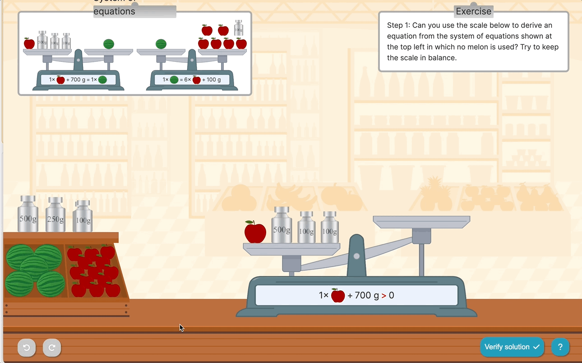
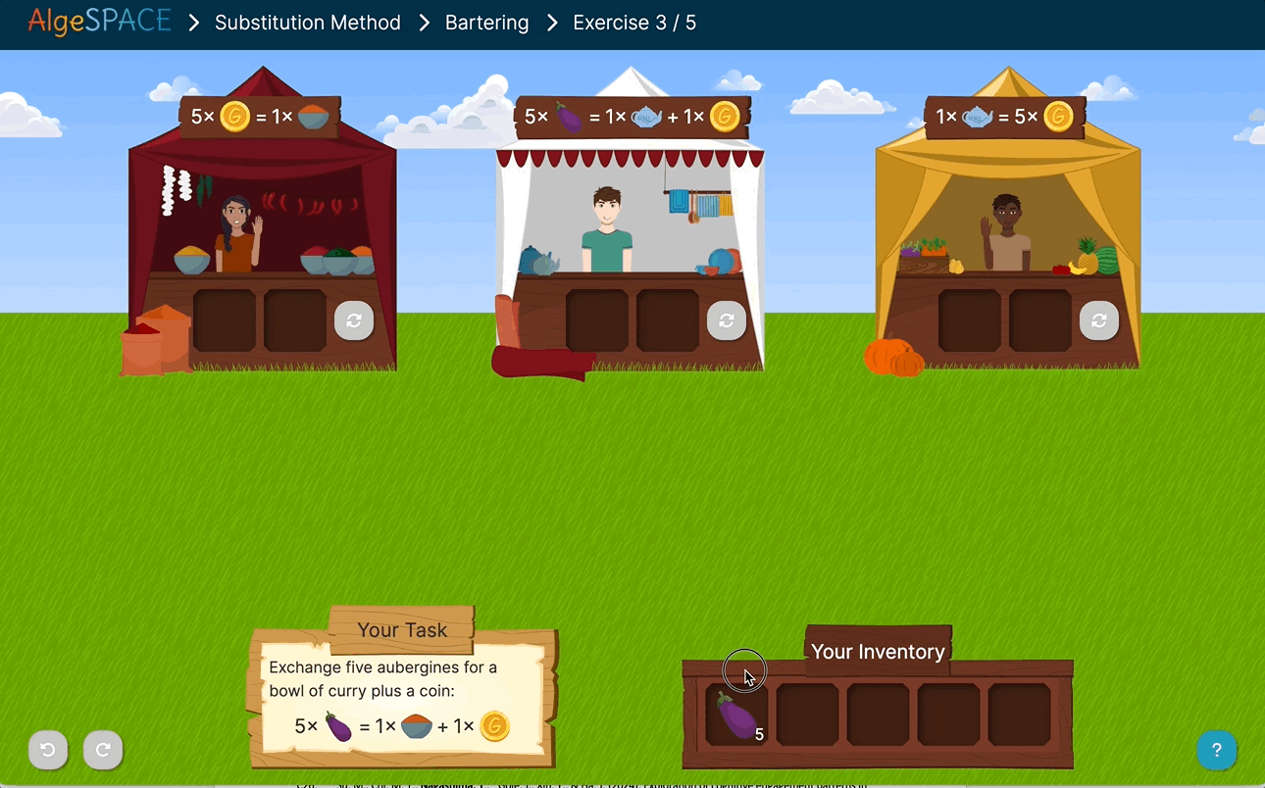

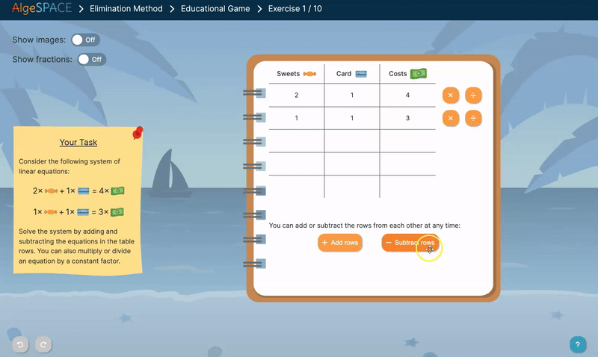
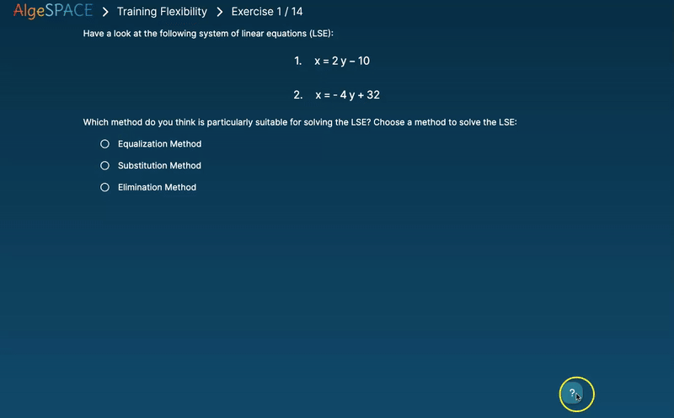
AlgeSPACE
Equalization Method
Substitution Method
https://algespace.sic.saarland/
No smartphone!
Use a tablet or computer
Elimination Method
Flexibility Training
Nagashima et al (2024)
Notes:
Step-by-step problem-solving tasks
Real-world concrete examples
Flexibility Training
Available in English and German.

Slide 6
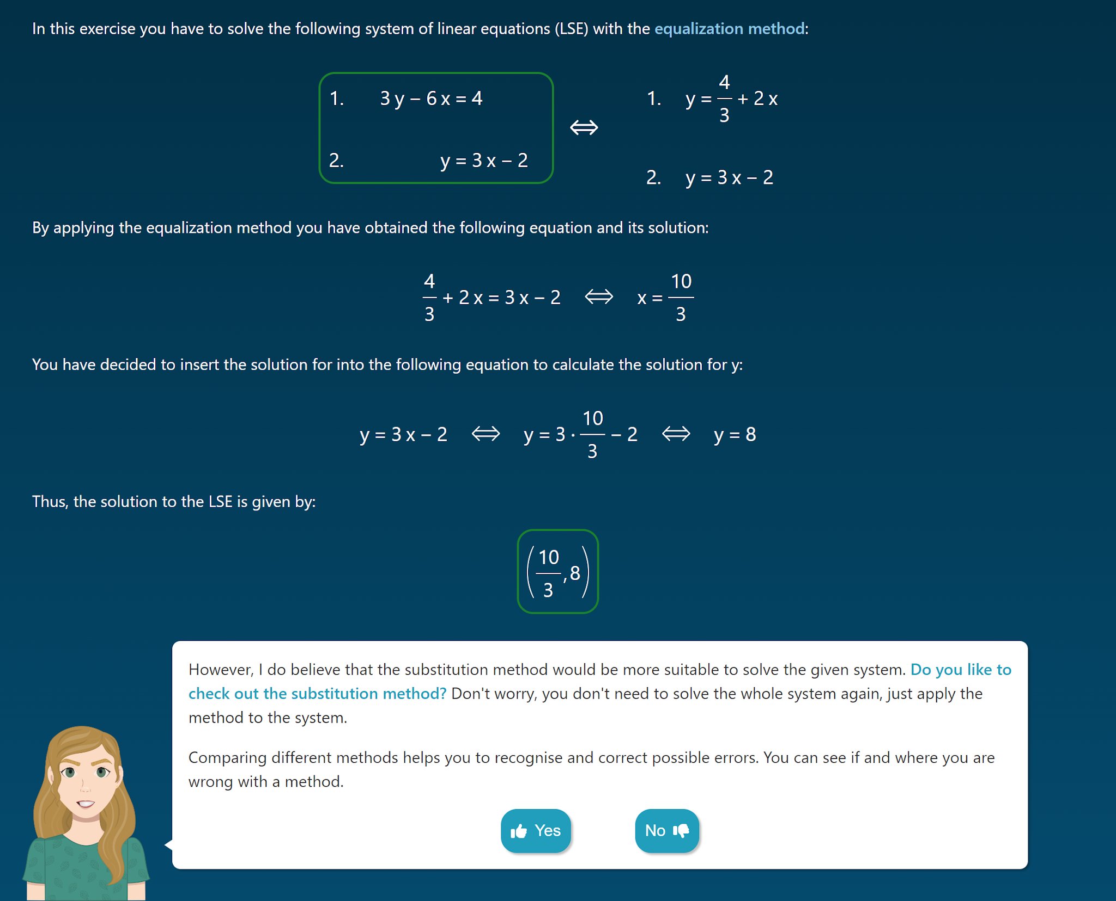
Supporting students’ choices and learning of solution strategies
Choose to engage with an optional metacognitive task

Slide 7
Supporting students’ choices and learning of solution strategies
“I think that the substitution method would be more suitable to solve the given system. Would you like to check out the substitution method?”
Choose to engage with an optional metacognitive task

Slide 8
Supporting students’ choices and learning of solution strategies
Choose to Resolve
“I think that the substitution method would be more suitable to solve the given system. Would you like to check out the substitution method?”
Choose to engage with an optional metacognitive task

Slide 9
Motivational prompts for different choice-making scenarios
Scenarios | Definition | Motivational Prompts
S1_WorkEx | Engagement with pre-solved worked examples. (Barbieri et al., 2023; Renkl, 2017) | “This helps you to remember the topics you have learnt and to solve upcoming tasks more efficiently. ”
S2_Self-Expl | Explaining their own solution strategy (by selecting proper statements from multiple options). (Rittle-Johnson et al., 2017) | “When explaining, you think about the best solutions, which strengthens your problem- solving skills”
S3_Comp | Comparing solutions with (fictional) peers. (Rittle-Johnson & Star, 2009) | “Comparing different methods deepens your understanding of mathematical concepts and how they are related.”
S4_Resolve | Resolving problems using new strategies. | “Trying out different methods shows you that there are often several ways to solve a problem.”
S5 & S6 1st & 2nd Sol | Manually solving for first & second unknown variables | “Manual calculations are required in many exams. Regular practice prepares you for this.”
S7 & S8 Adv_Equ &Adv_Sub | Engagement with complex Equalization or Substitution strategy. | “In this task, you will learn an additional strategy that can also help you with other tasks.”

Slide 10
Motivational prompts for different choice-making scenarios
Scenarios | Definition | Motivational Prompts
S1_WorkEx | Engagement with pre-solved worked examples. (Barbieri et al., 2023; Renkl, 2017) | “This helps you to remember the topics you have learnt and to solve upcoming tasks more efficiently. ”
S2_Self-Expl | Explaining their own solution strategy (by selecting proper statements from multiple options). (Rittle-Johnson et al., 2017) | “When explaining, you think about the best solutions, which strengthens your problem- solving skills”
S3_Comp | Comparing solutions with (fictional) peers. (Rittle-Johnson & Star, 2009) | “Comparing different methods deepens your understanding of mathematical concepts and how they are related.”
S4_Resolve | Resolving problems using new strategies. | “Trying out different methods shows you that there are often several ways to solve a problem.”
S5 & S6 1st & 2nd Sol | Manually solving for first & second unknown variables | “Manual calculations are required in many exams. Regular practice prepares you for this.”
S7 & S8 Adv_Equ &Adv_Sub | Engagement with complex Equalization or Substitution strategy. | “In this task, you will learn an additional strategy that can also help you with other tasks.”

Slide 11
Motivational prompts for different choice-making scenarios
Scenarios | Definition | Motivational Prompts
S1_WorkEx | Engagement with pre-solved worked examples. (Barbieri et al., 2023; Renkl, 2017) | “This helps you to remember the topics you have learnt and to solve upcoming tasks more efficiently. ”
S2_Self-Expl | Explaining their own solution strategy (by selecting proper statements from multiple options). (Rittle-Johnson et al., 2017) | “When explaining, you think about the best solutions, which strengthens your problem- solving skills”
S3_Comp | Comparing solutions with (fictional) peers. (Rittle-Johnson & Star, 2009) | “Comparing different methods deepens your understanding of mathematical concepts and how they are related.”
S4_Resolve | Resolving problems using new strategies. | “Trying out different methods shows you that there are often several ways to solve a problem.”
S5 & S6 1st & 2nd Sol | Manually solving for first & second unknown variables | “Manual calculations are required in many exams. Regular practice prepares you for this.”
S7 & S8 Adv_Equ &Adv_Sub | Engagement with complex Equalization or Substitution strategy. | “In this task, you will learn an additional strategy that can also help you with other tasks.”

Slide 12
Motivational prompts for different choice-making scenarios
Scenarios | Definition | Motivational Prompts
S1_WorkEx | Engagement with pre-solved worked examples. (Barbieri et al., 2023; Renkl, 2017) | “This helps you to remember the topics you have learnt and to solve upcoming tasks more efficiently. ”
S2_Self-Expl | Explaining their own solution strategy (by selecting proper statements from multiple options). (Rittle-Johnson et al., 2017) | “When explaining, you think about the best solutions, which strengthens your problem- solving skills”
S3_Comp | Comparing solutions with (fictional) peers. (Rittle-Johnson & Star, 2009) | “Comparing different methods deepens your understanding of mathematical concepts and how they are related.”
S4_Resolve | Resolving problems using new strategies. | “Trying out different methods shows you that there are often several ways to solve a problem.”
S5 & S6 1st & 2nd Sol | Manually solving for first & second unknown variables | “Manual calculations are required in many exams. Regular practice prepares you for this.”
S7 & S8 Adv_Equ &Adv_Sub | Engagement with complex Equalization or Substitution strategy. | “In this task, you will learn an additional strategy that can also help you with other tasks.”

Slide 13
Motivational prompts for different choice-making scenarios
Scenarios | Definition | Motivational Prompts
S1_WorkEx | Engagement with pre-solved worked examples. (Barbieri et al., 2023; Renkl, 2017) | “This helps you to remember the topics you have learnt and to solve upcoming tasks more efficiently. ”
S2_Self-Expl | Explaining their own solution strategy (by selecting proper statements from multiple options). (Rittle-Johnson et al., 2017) | “When explaining, you think about the best solutions, which strengthens your problem- solving skills”
S3_Comp | Comparing solutions with (fictional) peers. (Rittle-Johnson & Star, 2009) | “Comparing different methods deepens your understanding of mathematical concepts and how they are related.”
S4_Resolve | Resolving problems using new strategies. | “Trying out different methods shows you that there are often several ways to solve a problem.”
S5 & S6 1st & 2nd Sol | Manually solving for first & second unknown variables | “Manual calculations are required in many exams. Regular practice prepares you for this.”
S7 & S8 Adv_Equ &Adv_Sub | Engagement with complex Equalization or Substitution strategy. | “In this task, you will learn an additional strategy that can also help you with other tasks.”

Slide 14
Motivational prompts for different choice-making scenarios
Scenarios | Definition | Motivational Prompts
S1_WorkEx | Engagement with pre-solved worked examples. (Barbieri et al., 2023; Renkl, 2017) | “This helps you to remember the topics you have learnt and to solve upcoming tasks more efficiently. ”
S2_Self-Expl | Explaining their own solution strategy (by selecting proper statements from multiple options). (Rittle-Johnson et al., 2017) | “When explaining, you think about the best solutions, which strengthens your problem- solving skills”
S3_Comp | Comparing solutions with (fictional) peers. (Rittle-Johnson & Star, 2009) | “Comparing different methods deepens your understanding of mathematical concepts and how they are related.”
S4_Resolve | Resolving problems using new strategies. | “Trying out different methods shows you that there are often several ways to solve a problem.”
S5 & S6 1st & 2nd Sol | Manually solving for first & second unknown variables | “Manual calculations are required in many exams. Regular practice prepares you for this.”
S7 & S8 Adv_Equ &Adv_Sub | Engagement with complex Equalization or Substitution strategy. | “In this task, you will learn an additional strategy that can also help you with other tasks.”

Slide 15
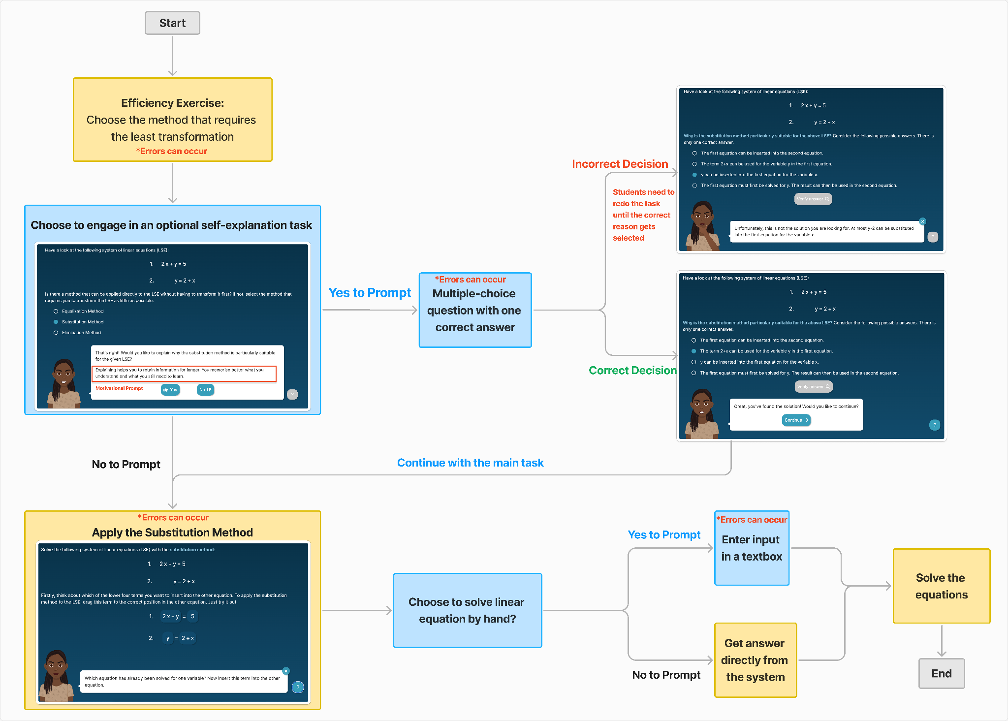
Supporting students’ choices and learning of solution strategies
A choice architecture that values autonomy over compliance
No negative feedback if students decline optional tasks (i.e., students can keep saying “No”).

Slide 16
Supporting students’ choices and learning of solution strategies
A choice architecture that values autonomy over compliance
No negative feedback if students decline optional tasks (i.e., students can keep saying “No”).
Yes
No

Slide 17
Study Design
Participants: 49 German high school students (Grades 9–10)
Design:
Agent condition: With motivational PAs
Non-Agent condition: Same tasks, no motivational prompts
Procedure (60 mins total):
Pretest (10 min)
Tutorial (interactive)
Learning session (25 min)
Posttest (10 min)
Exit questionnaire
Analysis:
Pre/post conceptual test scores
Choice-making frequency
Process mining & lag sequential analysis to explore learning behaviors

Slide 18
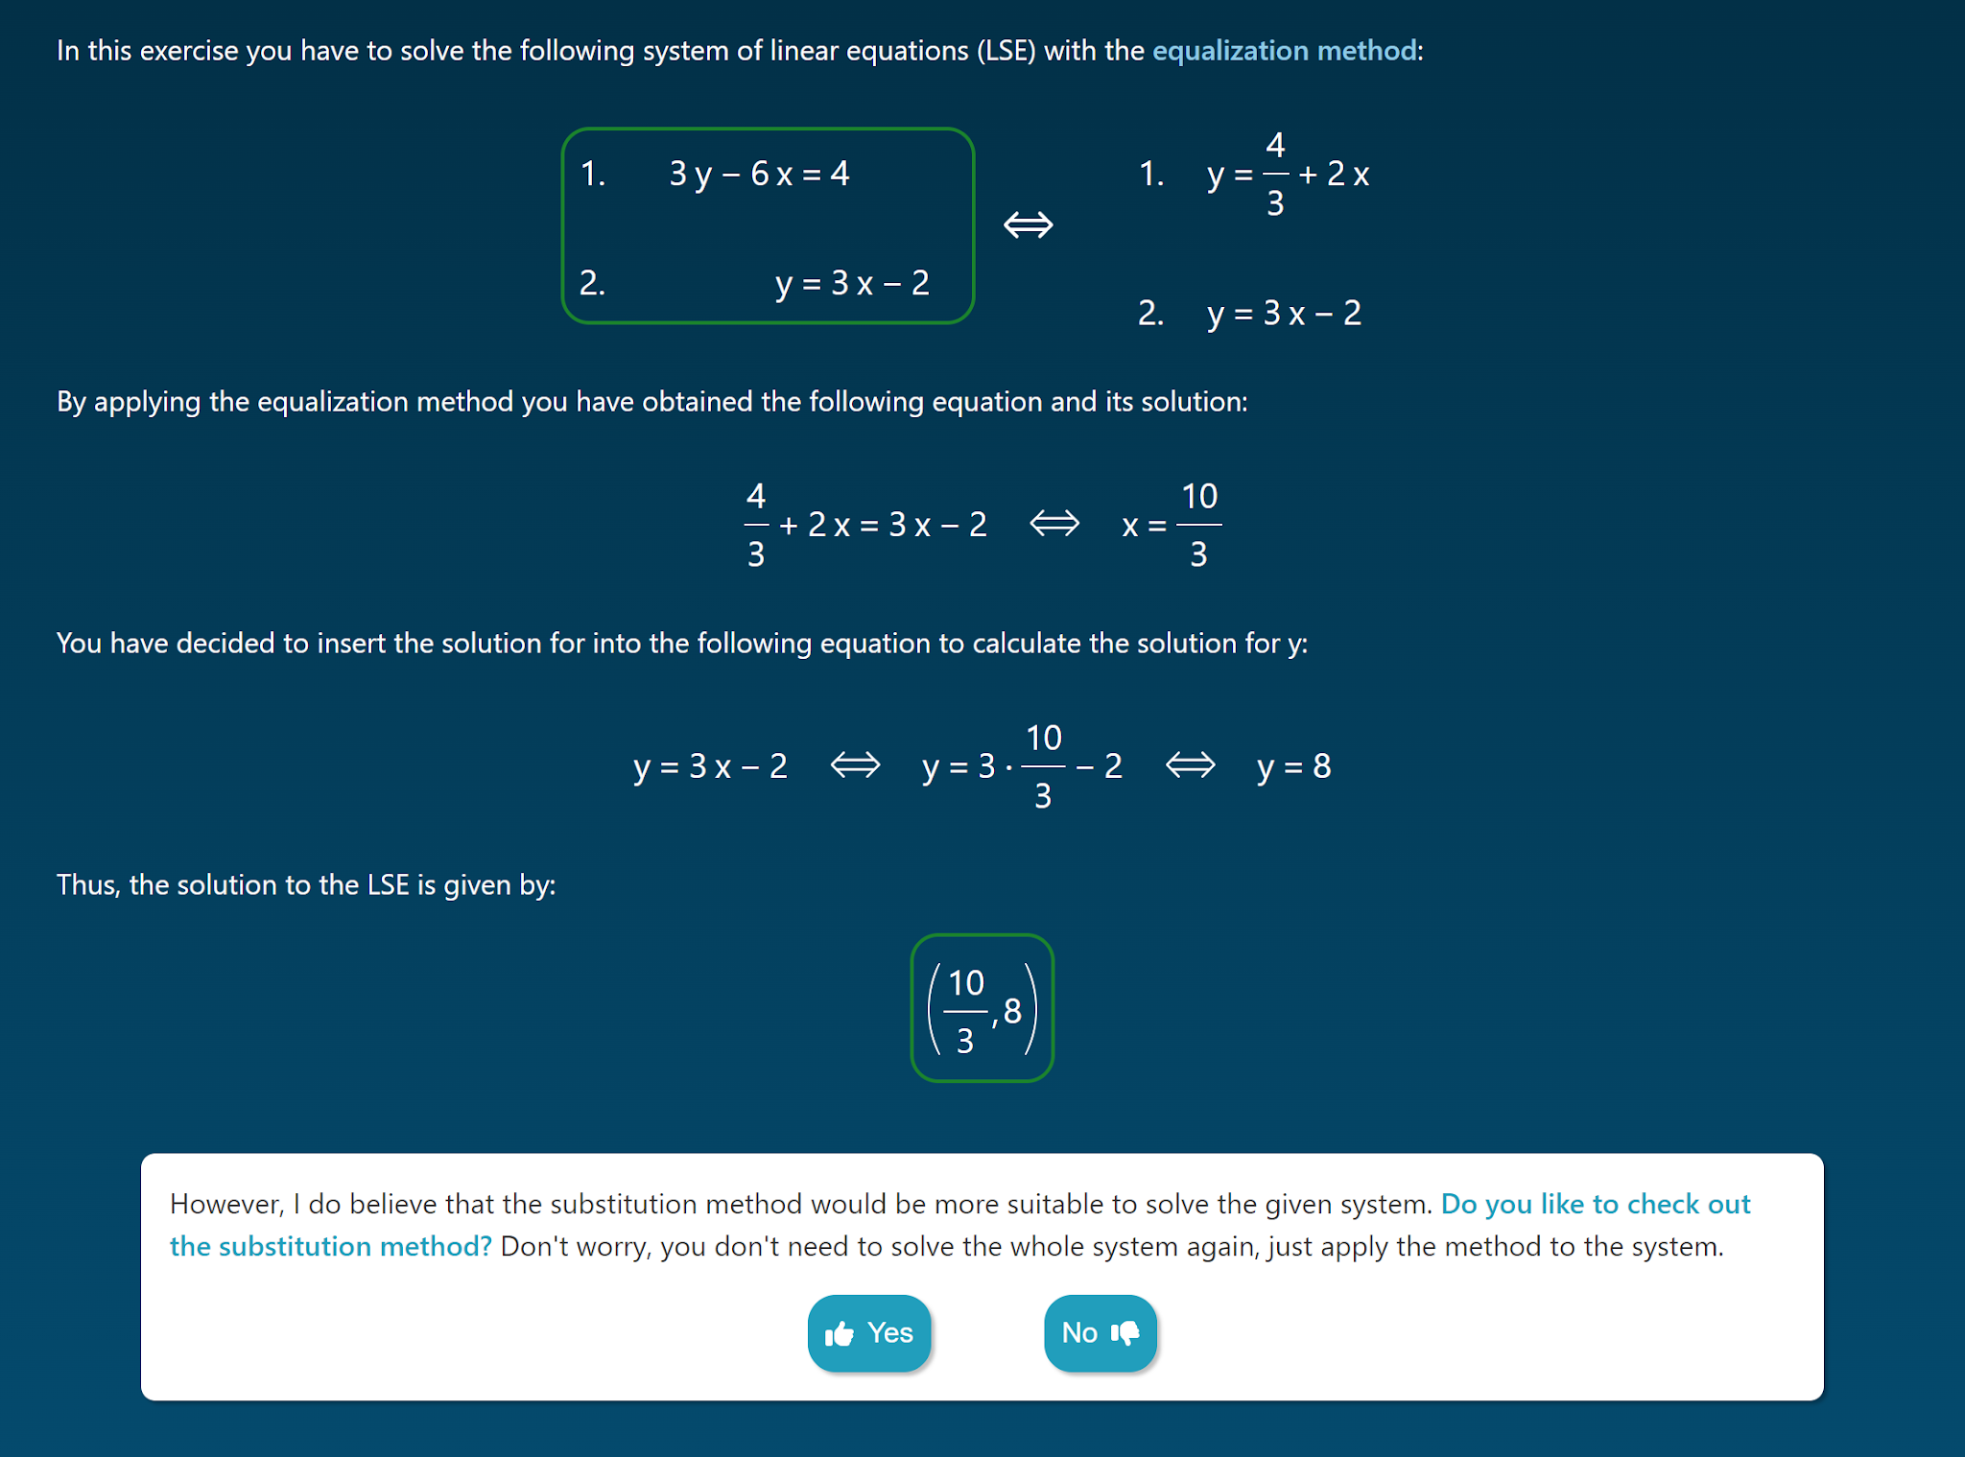
Pedagogical agents and motivational messages
How do motivational pedagogical agents impact students’ conceptual learning and choice-making behaviors?
Agents + Motivational messages
No Agents, No Motivational messages

Slide 19
Pedagogical agents and motivational messages
How do motivational pedagogical agents impact students’ conceptual learning and choice-making behaviors?
Agents + Motivational messages
No Agents, No Motivational messages

Slide 20
Pedagogical agents and motivational messages
How do motivational pedagogical agents impact students’ conceptual learning and choice-making behaviors?
Agents + Motivational messages
No Agents, No Motivational messages

Slide 21
Key findings
Conceptual Gains:

Slide 22
Key findings
Conceptual Gains:
Agent condition showed a trend toward higher learning gains (p = .064)

Slide 23
Key findings
Conceptual Gains:
Agent condition showed a trend toward higher learning gains (p = .064)
Significant gain for low prior knowledge students in the Agent condition (p = .002)

Slide 24
Key findings
Students articulated their conceptual reasoning well
Conceptual Gains:
Agent condition showed a trend toward higher learning gains (p = .064)
Significant gain for low prior knowledge students in the Agent condition (p = .002)

Slide 25
Key findings
Conceptual Gains:
Agent condition showed a trend toward higher learning gains (p = .064)
Significant gain for low prior knowledge students in the Agent condition (p = .002)
Choice-Making Patterns:
No differences between the conditions, but..

Slide 26
Key findings
Conceptual Gains:
Agent condition showed a trend toward higher learning gains (p = .064)
Significant gain for low prior knowledge students in the Agent condition (p = .002)
Choice-Making Patterns:
High Prior Knowledge: Confident, skipped worked examples (introduced early on) → higher failure rate on later challenges

Slide 27
Key findings
Conceptual Gains:
Agent condition showed a trend toward higher learning gains (p = .064)
Significant gain for low prior knowledge students in the Agent condition (p = .002)
Choice-Making Patterns:
High Prior Knowledge: Confident, skipped worked examples (introduced early on) → higher failure rate on later challenges
Low Prior Knowledge: Cautious, engaged in worked examples → better preparation over time

Slide 28
Key findings
Conceptual Gains:
Agent condition showed a trend toward higher learning gains (p = .064)
Significant gain for low prior knowledge students in the Agent condition (p = .002)
Choice-Making Patterns:
High Prior Knowledge: Confident, skipped worked examples (introduced early on) → higher failure rate on later challenges
Low Prior Knowledge: Cautious, engaged in worked examples → better preparation over time

Slide 29
Key findings
Conceptual Gains:
Agent condition showed a trend toward higher learning gains (p = .064)
Significant gain for low prior knowledge students in the Agent condition (p = .002)
Choice-Making Patterns:
High Prior Knowledge: Confident, skipped worked examples (introduced early on) → higher failure rate on later challenges
Low Prior Knowledge: Cautious, engaged in worked examples → better preparation over time
Effects of Choices on Learning:
Those who chose to work on optional tasks more frequently learned more from the intervention

Slide 30
Key takeaways
We need to help students use appropriate solution methods for linear systems of equations, and help them spontaneously use metacognitive strategies/activities
AlgeSPACE helped (low-prior knowledge) students, when their spontaneous choices (to engage or not with metacognitive activities) are supported with motivational pedagogical agents, learn greater conceptual knowledge
Fine-grained analyses demonstrated that low-prior knowledge students took a cautious approach in using metacognitive strategies to better scaffold their use of solution strategies, compared to high-prior knowledge students whose interactions are driven by confidence
Students who spontaneously engaged with optional metacognitive activities learned greater conceptual knowledge
Technologies both as a tool to support conceptual learning and a platform for measuring the use of metacognitive strategies

Slide 31



Man Su, Ph.D.
Postdoc
Learning to Adapt, Learning with Agency Lab (LaLa Lab)
Saarland Informatics Campus, Saarland University
mansu@cs.uni-saarland.de | mansu.net
Man Su
(project postdoc)
Katharina Bonaventura
(developer & designer)
Tomo Nagashima
(supervisor)
Interested in using/seeing the tool? Visit:
https://algespace.sic.saarland/
We thank all the participants who participated in the study.

Slide 32
Tomo Nagashima, Ph.D.
Assistant Professor of Technology-Enhanced Learning
Saarland Informatics Campus, Saarland University
Faculty Associate, Harvard University’s Berkman Klein Center for Internet & Society
nagashima@cs.uni-saarland.de | tomonag.org | @tomonag.bsky.social‬
🚀We are hiring!🚀
3 Humboldt Research Fellows/Postdocs!
You are/have…
Doctorate in the past 12 years (or soon)?
Living outside of Germany?
Research in Math Ed, Learning Sciences, Psych, and/or CS?
Interest in interdisciplinary research?
We offer…
2 years of postdoc fellowship in Germany through the Humboldt Foundation
Your own research fund (approx. 19,000 Euros), work on what you want
Mini “lab director” experience
Prestigious fellowship with networking opportunities and additional benefits to support your stay
Man Su
(project postdoc)
Katharina Bonaventura
(developer & designer)
Tomo Nagashima
(supervisor)
Interested in using/seeing the tool? Visit:
https://algespace.sic.saarland/
We thank all the participants who participated in the study.

